Slide 1
Outline of the course
unknown
RL
known
deterministic
stochastic
atomic
SEARCH
MDPs
factored
LOGIC
Bayes nets
structured
First-order logic

Slide 2
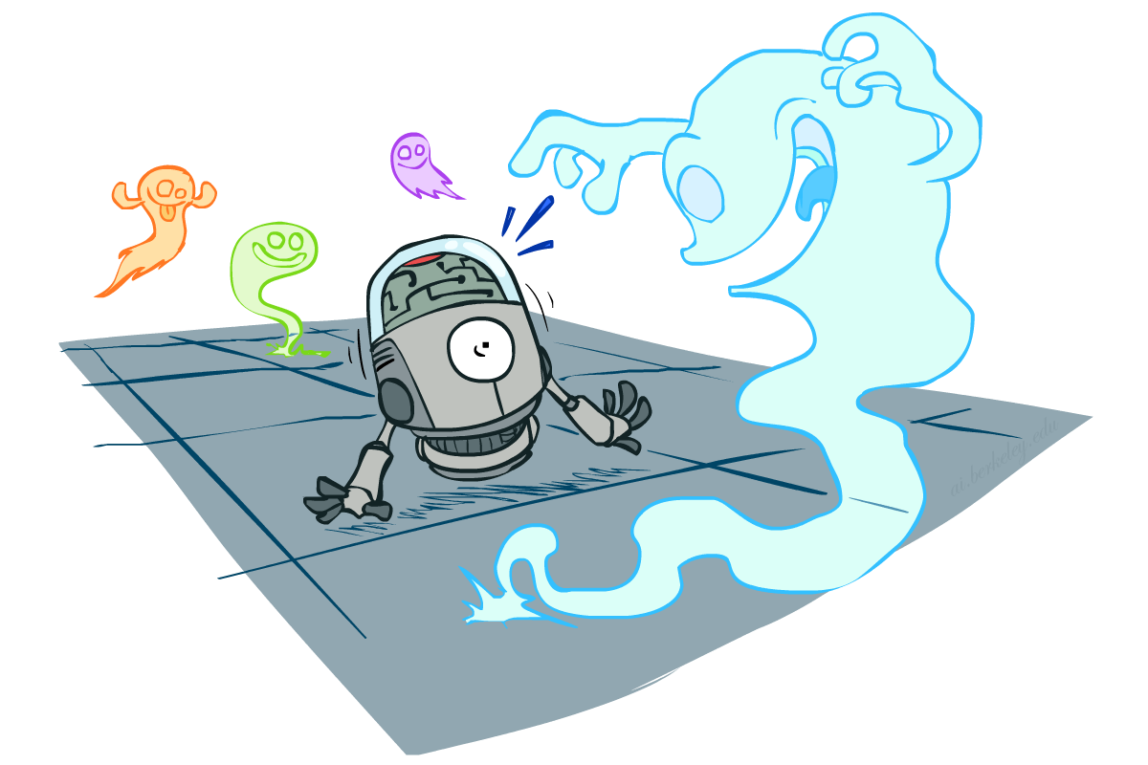
CS 188: Artificial Intelligence
Probability
Instructors: Stuart Russell and Dawn Song
University of California, Berkeley
Notes:
Please retain proper attribution, including the reference to ai.berkeley.edu. Thanks!

Slide 3
Uncertainty
The real world is rife with uncertainty!
E.g., if I leave for SFO 60 minutes before my flight, will I be there in time?
Problems:
partial observability (road state, other drivers’ plans, etc.)
noisy sensors (radio traffic reports, Google maps)
immense complexity of modelling and predicting traffic, security line, etc.
lack of knowledge of world dynamics (will tire burst? need COVID test?)
Probabilistic assertions summarize effects of ignorance and laziness
Combine probability theory + utility theory -> decision theory
Maximize expected utility : a* = argmax_{a} ∑_{s} P(s | a) U(s)

Slide 4
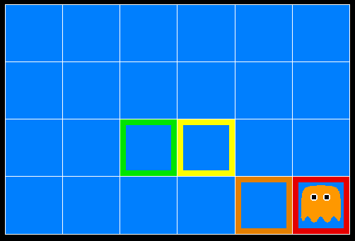
Inference in Ghostbusters
A ghost is in the grid somewhere
Sensor readings tell how close a square is to the ghost
On the ghost: red
1 or 2 away: orange
3 or 4 away: yellow
5+ away: green
Sensors are noisy, but we know P(Color(x,y) | DistanceFromGhost(x,y))
P(red | 3) | P(orange | 3) | P(yellow | 3) | P(green | 3)
0.05 | 0.15 | 0.5 | 0.3

Slide 5

Video of Demo Ghostbusters – No probability

Slide 6
Basic laws of probability
Begin with a set Ω of possible worlds
E.g., 6 possible rolls of a die, {1, 2, 3, 4, 5, 6}
A probability model assigns a number P(ω) to each world ω
E.g., P(1) = P(2) = P(3) = P(5) = P(5) = P(6) = 1/6.
These numbers must satisfy
0 ≤ P(ω) ≤ 1
∑_{ω ∈Ω} P(ω) = 1

Slide 7
Basic laws contd.
An event is any subset of Ω
E.g., “roll < 4” is the set {1,2,3}
E.g., “roll is odd” is the set {1,3,5}
The probability of an event is the sum of probabilities over its worlds
P(A) = ∑_{ω ∈ A} P(ω)
E.g., P(roll < 4) = P(1) + P(2) + P(3) = 1/2
De Finetti (1931): anyone who bets according to probabilities that violate these laws can be forced to lose money on every set of bets

Slide 8

Random Variables
A random variable (usually denoted by a capital letter) is some aspect of the world about which we (may) be uncertain
Formally a deterministic function of ω
The range of a random variable is the set of possible values
Odd = Is the dice roll an odd number? → {true, false}
e.g. Odd(1)=true, Odd(6) = false
often write the event Odd=true as odd, Odd=false as ¬odd
T = Is it hot or cold? → {hot, cold}
D = How long will it take to get to the airport? → [0, ∞)
L_{Ghost} = Where is the ghost? → {(0,0), (0,1), …}
The probability distribution of a random variable X gives the probability for each value x in its range (probability of the event X=x)
P(X=x) = ∑ _{{ω: X(ω)=x}} P(ω)
P(x) for short (when unambiguous)
P(X) refers to the entire distribution (think of it as a vector or table)

Slide 9
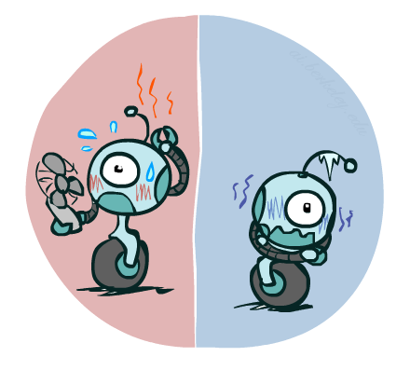
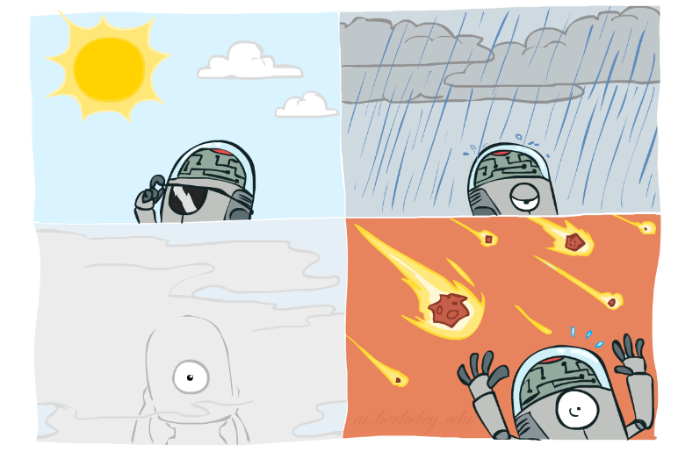
Probability Distributions
Associate a probability with each value; sums to 1
Temperature:
Weather:
Joint distribution
P(W)
P(T,W)
P(T)
W | P
sun | 0.6
rain | 0.1
fog | 0.3
meteor | 0.0
T | P
hot | 0.5
cold | 0.5
 |  | Temperature
 |  | hot | cold
Weather | sun | 0.45 | 0.15
 | rain | 0.02 | 0.08
 | fog | 0.03 | 0.27
 | meteor | 0.00 | 0.00

Slide 10
Making possible worlds
In many cases we
begin with random variables and their domains
construct possible worlds as assignments of values to all variables
E.g., two dice rolls Roll₁ and Roll₂
How many possible worlds?
What are their probabilities?
Size of distribution for n variables with range size d?
For all but the smallest distributions, cannot write out by hand!
d^{n}

Slide 11
Probabilities of events
Recall that the probability of an event is the sum of probabilities of its worlds:
P(A) = ∑_{ω ∈ A} P(ω)
So, given a joint distribution over all variables, can compute any event probability!
Probability that it’s hot AND sunny?
Probability that it’s hot?
Probability that it’s hot OR not foggy?
Joint distribution
P(T,W)
 |  | Temperature
 |  | hot | cold
Weather | sun | 0.45 | 0.15
 | rain | 0.02 | 0.08
 | fog | 0.03 | 0.27
 | meteor | 0.00 | 0.00

Slide 12
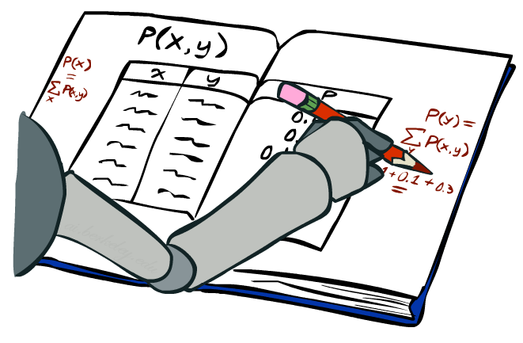
Marginal Distributions
Marginal distributions are sub-tables which eliminate variables
Marginalization (summing out): Collapse a dimension by adding
P(X=x) = ∑_{y} P(X=x, Y=y)
 |  | Temperature
 |  | hot | cold
Weather | sun | 0.45 | 0.15
 | rain | 0.02 | 0.08
 | fog | 0.03 | 0.27
 | meteor | 0.00 | 0.00
0.60
0.10
0.30
0.00
P(W)
0.50 | 0.50
P(T)

Slide 13
Conditional Probabilities
A simple relation between joint and conditional probabilities
In fact, this is taken as the definition of a conditional probability
P(a,b)
P(a, b)
P(b)
P(a | b) =
P(T,W)
P(a)
P(b)
 |  | Temperature
 |  | hot | cold
Weather | sun | 0.45 | 0.15
 | rain | 0.02 | 0.08
 | fog | 0.03 | 0.27
 | meteor | 0.00 | 0.00
P(W=s,T=c)
P(T=c)
P(W=s | T=c) =
= 0.15/0.50 = 0.3
= P(W=s,T=c) + P(W=r,T=c) + P(W=f,T=c) + P(W=m,T=c)
= 0.15 + 0.08 + 0.27 + 0.00= 0.50

Slide 14
Conditional Distributions
Distributions for one set of variables given another set
P(W | T=h)
P(W | T=c)
P(W | T)
 |  | Temperature
 |  | hot | cold
Weather | sun | 0.45 | 0.15
 | rain | 0.02 | 0.08
 | fog | 0.03 | 0.27
 | meteor | 0.00 | 0.00
hot
cold
hot
cold
0.90
0.04
0.06
0.00
0.30
0.16
0.54
0.00
0.90
0.04
0.06
0.00
0.30
0.16
0.54
0.00

Slide 15
Normalizing a distribution
(Dictionary) To bring or restore to a normal condition
Procedure:
Multiply each entry by α = 1/(sum over all entries)
All entries sum to ONE
P(W,T)
P(W | T=c) = P(W,T=c)/P(T=c)
= α P(W,T=c)
 |  | Temperature
 |  | hot | cold
Weather | sun | 0.45 | 0.15
 | rain | 0.02 | 0.08
 | fog | 0.03 | 0.27
 | meteor | 0.00 | 0.00
P(W,T=c)
0.15
0.08
0.27
0.00
0.30
0.16
0.54
0.00
Normalize
α = 1/0.50 = 2

Slide 16
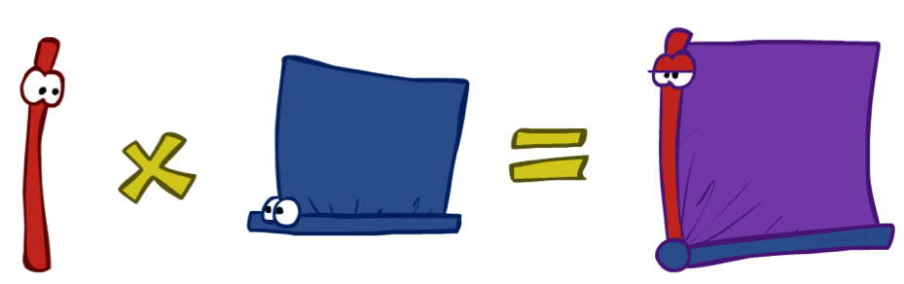
The Product Rule
Sometimes have conditional distributions but want the joint
P(a | b) P(b) = P(a, b)
P(a, b)
P(b)
P(a | b) =

Slide 17
The Product Rule: Example
P(W | T) P(T) = P(W, T)
P(W | T)
P(W, T)
hot
cold
 |  | Temperature
 |  | hot | cold
Weather | sun | 0.45 | 0.15
 | rain | 0.02 | 0.08
 | fog | 0.03 | 0.27
 | meteor | 0.00 | 0.00
P(T)
0.90
0.04
0.06
0.00
0.30
0.16
0.54
0.00
T | P
hot | 0.5
cold | 0.5

Slide 18
The Chain Rule
A joint distribution can be written as a product of conditional distributions by repeated application of the product rule:
P(x₁, x₂, x₃) = P(x₃ | x₁, x₂) P(x₁, x₂) = P(x₃ | x₁, x₂) P(x₂ | x₁) P(x₁)
P(x₁, x₂,…, x_{n}) = ∏_{i} P(x_{i} | x₁,…, x_{i-1})

Slide 19

Probabilistic Inference
Probabilistic inference: compute a desired probability from a probability model
Typically for a query variable given evidence
E.g., P(airport on time | no accidents) = 0.90
These represent the agent’s beliefs given the evidence
Probabilities change with new evidence:
P(airport on time | no accidents, 5 a.m.) = 0.95
P(airport on time | no accidents, 5 a.m., raining) = 0.80
Observing new evidence causes beliefs to be updated

Slide 20
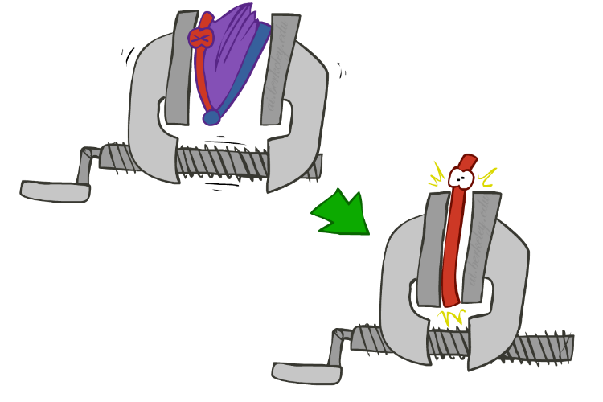
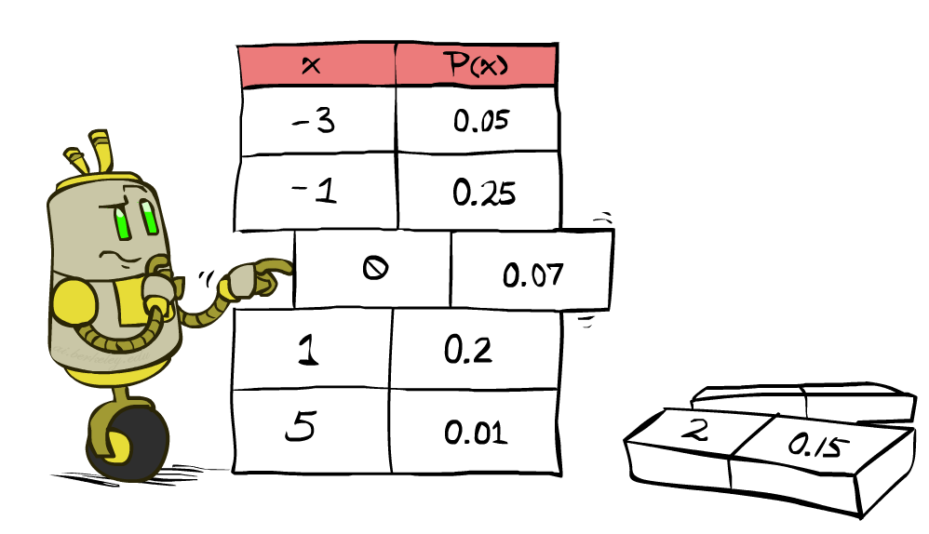
Inference by Enumeration
* Works fine with multiple query variables, too
General case:
Evidence variables: E₁, …, E_{k} = e₁, …,e_{k}
Query* variable: Q
Hidden variables: H₁, …, H_{r}
X₁, …, X_{n}
All variables
We want:
P(Q | e₁, …,e_{k})
Probability model P(X₁, …, X_{n}) is given
Step 1: Select the entries consistent with the evidence
Step 2: Sum out H from model to get joint of Query and evidence
Step 3: Normalize
P(Q | e₁,…,e_{k}) = α P(Q,e₁,…,e_{k})
P(Q,e₁,…,e_{k}) =
∑_{h1,…, hr}P(Q,h₁,…, h_{r}, e₁,…,e_{k})
X₁, …, X_{n}

Slide 21
Inference by Enumeration
Season | Temp | Weather | P
summer | hot | sun | 0.35
summer | hot | rain | 0.01
summer | hot | fog | 0.01
summer | hot | meteor | 0.00
summer | cold | sun | 0.10
summer | cold | rain | 0.05
summer | cold | fog | 0.09
summer | cold | meteor | 0.00
winter | hot | sun | 0.10
winter | hot | rain | 0.01
winter | hot | fog | 0.02
winter | hot | meteor | 0.00
winter | cold | sun | 0.15
winter | cold | rain | 0.20
winter | cold | fog | 0.18
winter | cold | meteor | 0.00
P(W)?

Slide 22
Inference by Enumeration
Season | Temp | Weather | P
summer | hot | sun | 0.35
summer | hot | rain | 0.01
summer | hot | fog | 0.01
summer | hot | meteor | 0.00
summer | cold | sun | 0.10
summer | cold | rain | 0.05
summer | cold | fog | 0.09
summer | cold | meteor | 0.00
winter | hot | sun | 0.10
winter | hot | rain | 0.01
winter | hot | fog | 0.02
winter | hot | meteor | 0.00
winter | cold | sun | 0.15
winter | cold | rain | 0.20
winter | cold | fog | 0.18
winter | cold | meteor | 0.00
P(W)?
P(W | winter)?

Slide 23
Inference by Enumeration
Season | Temp | Weather | P
summer | hot | sun | 0.35
summer | hot | rain | 0.01
summer | hot | fog | 0.01
summer | hot | meteor | 0.00
summer | cold | sun | 0.10
summer | cold | rain | 0.05
summer | cold | fog | 0.09
summer | cold | meteor | 0.00
winter | hot | sun | 0.10
winter | hot | rain | 0.01
winter | hot | fog | 0.02
winter | hot | meteor | 0.00
winter | cold | sun | 0.15
winter | cold | rain | 0.20
winter | cold | fog | 0.18
winter | cold | meteor | 0.00
P(W)?
P(W | winter)?
P(W | winter, hot)?

Slide 24
Inference by Enumeration
Obvious problems:
Worst-case time complexity O(d^{n})
Space complexity O(d^{n}) to store the joint distribution
O(d^{n}) data points to estimate the entries in the joint distribution

Slide 25
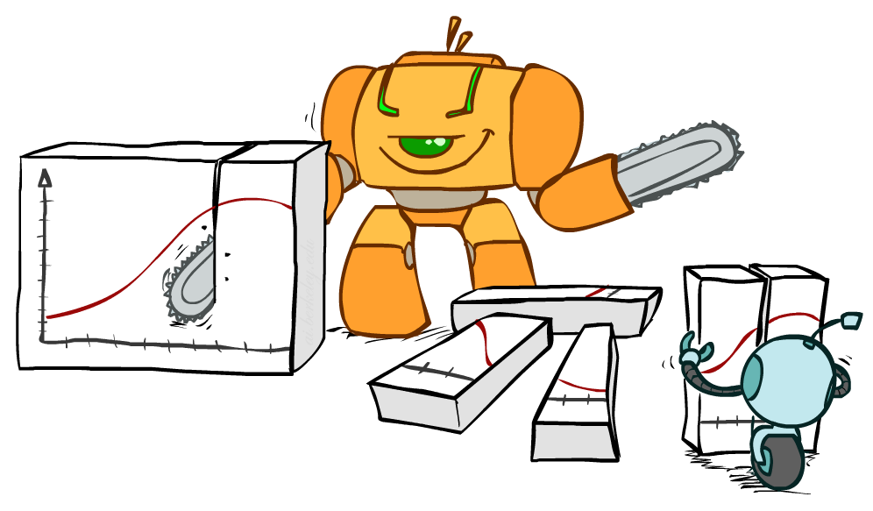
Bayes Rule

Slide 26
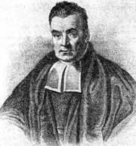
Bayes’ Rule
Write the product rule both ways:
P(a | b) P(b) = P(a, b) = P(b | a) P(a)
Dividing left and right expressions, we get:
Why is this at all helpful?
Lets us build one conditional from its reverse
Often one conditional is tricky but the other one is simple
Describes an “update” step from prior P(a) to posterior P(a | b)
Foundation of many systems we’ll see later (e.g. ASR, MT)
In the running for most important AI equation!
That’s my rule!
P(b | a) P(a)
P(b)
P(a | b) =

Slide 27
Inference with Bayes’ Rule
Example: Diagnostic probability from causal probability:
Example:
M: meningitis, S: stiff neck
Note: posterior probability of meningitis still very small: 0.008 (80x bigger – why?)
Note: you should still get stiff necks checked out! Why?
P(effect | cause) P(cause)
P(effect)
P(cause | effect) =
P(s | m) = 0.8
P(m) = 0.0001
P(s) = 0.01
Example
givens
P(s | m) P(m)
P(s)
0.8 x 0.0001 .
0.01
P(m | s) =
=

Slide 28
Next time
Independence
Conditional independence
Bayes nets

